Slide 1
Unlocking Wellness Behaviors: Strategic Insights from Smart Device Usage
Kashinath M Nair
Data Analyst

Slide 2

The Story Begins with Her
She wears her wellness on her wrist. Tracks her steps. Scrolls through sleep stats. But behind those numbers… something deeper is shaping her habits.

Slide 3
Understanding the Current Landscape
Across devices and days, the story remains consistent: low activity, poor sleep efficiency, missed benchmarks. This isn’t isolated behavior — it’s widespread. And in that repetition lies an opportunity Bellabeat can’t afford to ignore.

Slide 4
What We’re Seeing Has Consequences
Users fall short of basic wellness targets — daily. Most stay sedentary. Few sleep enough. Without meaningful engagement, Bellabeat risks missed retention, weak brand loyalty, and lost growth momentum in a highly competitive, fast-evolving smart wellness market.

Slide 5
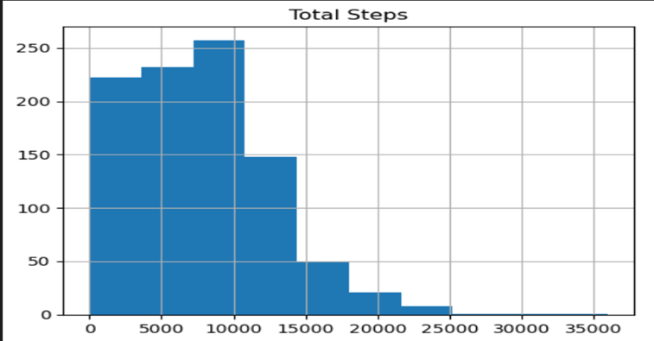
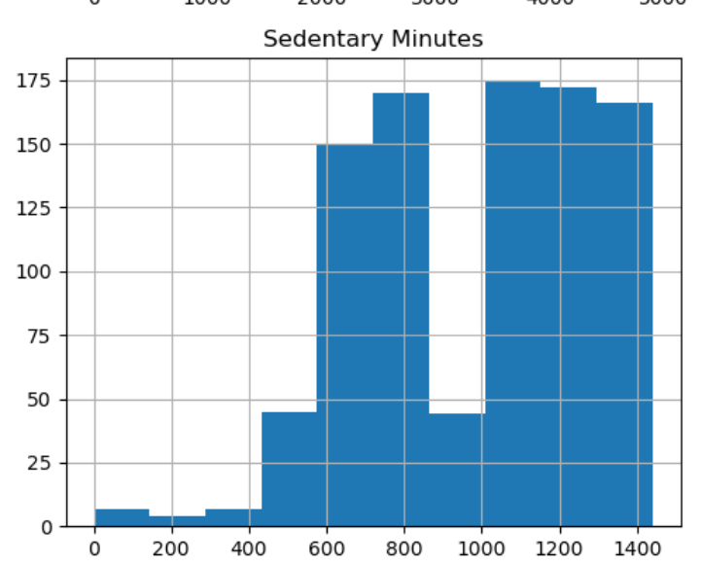
. Only few days where the user where able to meet their 10k goal. In figure 1, we can see most people have their daily steps between 0 to 10k.
A large share of users’ days are sedentary. One analysis found users spent ~81% of their tracked minutes sedentary and only ~2% in vigorous activity.

Slide 6
The Data Speaks — And It’s Actionable
Consistent patterns reveal leverage points: activity spikes in the evening, sleep improves next-day energy, intense minutes drive calorie burn. The insight? User behavior can be influenced — predictably. Bellabeat has the data to lead that transformation.

Slide 7
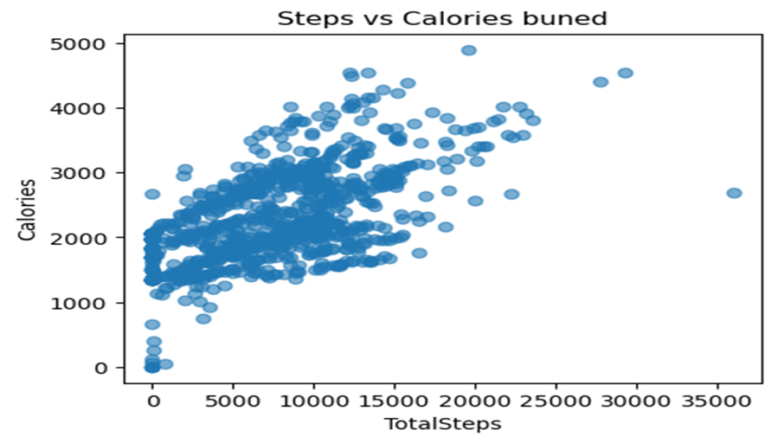
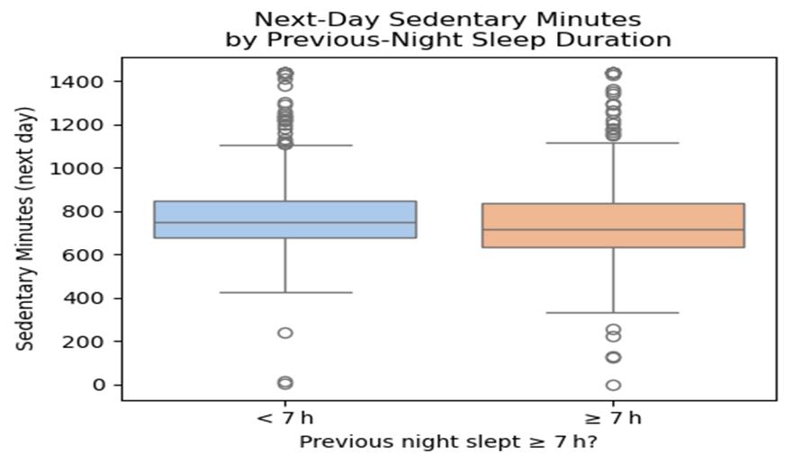
Steps and calorie expenditure are strongly linked. In our data and prior analyses, more steps (and active minutes) clearly produce higher calories burned.
Getting enough sleep appears to increase next-day activity. Users who slept ≥7 hours tended to be significantly less sedentary the following day (on average dozens of minutes more active).

Slide 8
From Insight to Impact
We’ve identified when, where, and how users fall short — and what motivates change. Now, we shift from observation to action: a targeted strategy designed to engage users, boost retention, and position Bellabeat for long-term competitive growth. Lets walk through some of the recommended things to do.

Slide 9
Launch a 1000 step challenge instead of pushing 10000 target. Small chnages, collective growth !!
Use reminder to break long sedentary periods
Reward daily streaks and sharing achievement in social media
Add hourly goals and real time feedback
Motivate users and educate them more about fitness and how important is it for a woman.
Suggest routines that fits busy schedules
Market “10mins to burn” campaigns
Encourage 7hours+ sleep(CDC backed)

Slide 10
Bellabeats impact..
Higher app usage, peak-time engagement, daily step count
Better feature fit & membership appeal.
Increased CTRs, conversion rates, and brand trust.
Stronger wellness positioning in global market.
Users gain better sleep, movement, and motivation, which Drives retention, loyalty, and brand advocacy.
Bellabeat becomes a behavior-smart, habit-first brand

Slide 11
Turning Insight Into Impact
The data is clear: small behavioral shifts drive big wellness outcomes. With smart nudges, time-aware engagement, and habit-first messaging, Bellabeat can lead the way in personalized wellness — deepening user trust, expanding growth, and strengthening its market position.

Slide 12
QNA

